Slide 1
Strategic thinking process

Slide 2
The Process:
Phase 1 Reaching A Shared Understanding
Phase 2 Drilling Down
Phase 3 Decision Making

Slide 3
The Process:
Phase 1 Jan - July, organisational learnings, 12 interviews, staff survey & membership survey
Phase 2 Drilling Down July - December, Theory of Change and PESTLE. Staff, Bureau, General Assembly, EEP
Phase 3 Decision Making Jan - September, Bureau,EEP NC, ExCo, EUISG, General Assembly

Slide 4
The Process: Today
6 Themes
6 Proposed Priority Actions
6 Proposed Recommended Changes
End of the Day - Agreed Action Points

Slide 5
Strengths:
Unique role of EAPN
Collegiality of the Network
Buy in to EAPN vision

Slide 6
Unique role of EAPN:
Uniquely placed among European networks
Wide & diverse membership
Breadth of ‘voice’
High standing with Commission

Slide 7
Unique role of EAPN:
It is really helpful to use the name of EAPN when we are talking with our national Governments – it is like having a family that supports us and having good luck when you have problems.
We know things about EU processes before our own civil servants do
We absolutely recognised the unique relationship EAPN has with the Commission, this is a key asset of the organisation.

Slide 8
Collegiality of the network:
Members values opportunities for shared learning
Best practice
Informal learning

Slide 9
Collegiality of the network:
I am always enthused when I go to Brussels, because it reminds me that we have the ability to fight and to advocate.
The European wide work makes me enthusiastic, meeting people in the Brussels office and exchanging views is very interesting. Even though there are dark clouds in Europe politics at the moment, there is some hope that European politics will go in a better direction. Because the network is very large, there is always something new.

Slide 10
Buy in for EAPN vision and values:
In 25 years’ time EAPN should not exist because poverty and inequality no longer exist in Europe. EAPN should be the reference organisation in the meantime. EAPN should not restrict itself to Europe - we need to go worldwide, the SDGs should be achieved in 25 years, we need to make the whole world fair and sustainable.
When we are thinking about our long term vision we need to acknowledged that climate change and digitisation alone will change things substantially. I would like to see EAPN become a stronger network, with more people directly connected to it, with more NGOs and more parts of civil society engaged with it.
We should add a focus on equality and sustainability, to help connect the social and environmental fields, which could become increasingly intertwined over the next 25 years because of the impacts of climate change.

Slide 11
Buy in for EAPN vision and values:
A Social Europe free of poverty and social exclusion with access to economic, social and cultural rights for all
90% agreement

Slide 12
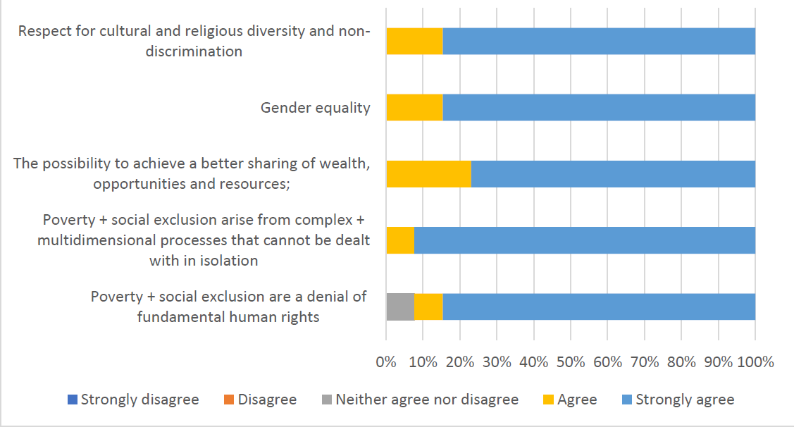

Slide 13
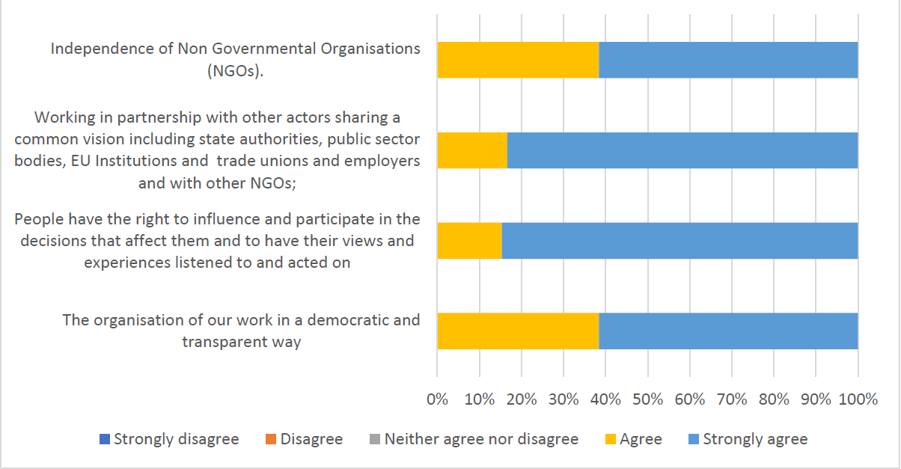

Slide 14
Ideas on values
Sustainable development, equality, global democracy & the reinforcement of international human rights
Interdependence of social, environment and economic goals
More focus on quality of work, dignity of workers and their families
Delivery of Agenda 2030 and SDGs
Reinforce value of civil society and social partners
Solidarity with non Eu citizens arriving on our boarders
Direct involvement of experts with experience of poverty

Slide 15
Challenges:
Identity
Analysis
Participation
Membership engagement
Human Resources
Structural Change

Slide 16
Identity:
The Identity of EAPN is constrained by it’s relationship with, and financial dependence upon, the Commission
Notes:
EAPN
was ‘born’ from Commission conferences in 1989 and 1990. While EAPN does receive limited funding from other sources, a substantial proportion of its funding has always come from the Commission. This has significant implications including an identity clash from being so closely interlinked with the Commission, a threat to sustainability from current financial reliance on the Commission, and potentially influencing structures that may create unnecessary bureaucracy.
The work programme of EAPN is dominated by responding to Commission processes, and while this has yielded some successes, these processes are technical, time consuming and often challenging to make relevant to national members let alone to people living in poverty. This level of engagement in Commission processes also creates an internal identity clash: EAPN identifies itself as an organisation championing the voices of people experiencing poverty, however, a substantial proportion of its work is not accessible to a lay audience.

Slide 17
Identity:
Work programme heavily focused on commission processes
Technical, time consuming, and hard to translate into live reality of people experiencing poverty
Risk of funding coming from one dominant sources
Voting structures echo EU

Slide 18
Identity:
The Commission has an increasingly instrumentalist approach and wants us only to produce research data for them and support implementation of their policies.. i.e. not a critical voice.
EAPN choose to get tied up in technical processes, they are not required to.
The Semester process only works if the national Governments are going to do the work anyway, it is a burdensome process with little in the way of deliverables.
The commission are getting more critical, they are asking more questions about value for money, EAPN is undoubtedly valued, but it would be foolish not to be seeking funding elsewhere.

Slide 19
Identity: The identity of EAPN is constrained by its relationships with the Commission
Priority Action:
The income diversification strategy needs to be prioritized, with an analysis of potential income sources and opportunities completed in parallel with the strategic review process (ie within a year).
Recommended Change:
Equal voting rights among members should be adopted at the General Assembly to underpin solidarity among members.

Slide 20
Analysis: EAPN would benefit from a clearer shared political analysis

Slide 21
Analysis: EAPN would benefit from a clearer shared political analysis
Analysis on key political issues not always clear
Policy positions not always concise and accessible
Not clear that all members share understanding
Technical processes, with multiple issues compounds this
Without a clear Theory of Change EAPN cannot:
Prioritize actions & resources
Measure impact
Respond to changes in political environment rapidly

Slide 22
Analysis: EAPN would benefit from a clearer shared political analysis
We need to begin with a political vision and recommit ourselves to this.
There was a paper issued recently by EAPN on migration, but we don’t have a unanimous stand on this – we also don’t have one on poverty or gender either.
Sometimes when we discuss issues in plenary and working groups it is clear that not all people agree on the basic assumptions. We need to have a basic framework that everyone is aligned to on human rights, civic rights and social welfare.

Slide 23
If we were to be more effective at achieving our Vision
Activities:
Develop true clarity on our purpose Really listen to EEP Publicly track political commitments
Strategies:
Agree small number of common priorities Exchange with other regions in the world Modernize our ways of working & output for more impact Relationships with like minded organisations Strengthen the networks & enable participation of members
Topics:
Economic, social and cultural rights - linking to the SDGs
Well being, feeling of belonging - social cohesion

Slide 24
2. Analysis: EAPN would benefit from a clearer shared political analysis
Priority Action:
The Director to lead the development of a Theory of Change for EAPN, with inputs from the Secretariat and engagement opportunities for the membership and for people experiencing poverty.
Recommended Change:
EAPN to translate its Values statements into accessible analysis documents that inform the work programme. The Implementation of the values to be monitored as part of evaluation framework for all EAPN activities, reports on which will be communicated to the membership to build ownership and accountability.

Slide 25
Participation: While participation is highly valued, it is not always clearly understood

Slide 26
Participation: While participation is highly valued, it is not always clearly understood
Participation of PEP core to the identity of EAPN
Dutch motion - no clear pathway

Slide 27
Participation: While participation is highly valued, it is not always clearly understood
Right now, EAPN is mostly member led, and PEP have a secondary role, in the national organisations we are succeeding in getting people participating in leadership roles. If we claim we are an organisation that defends PEP we need to have them more integrated into the organisation
The annual meeting leaves people incredibly frustrated, they get nothing back.
We have all these recommendations arising at the end of the meeting of people experiencing poverty and they don’t go anywhere
People experiencing poverty and vulnerability need to own EAPN – to be the leaders, not just the participants.

Slide 28
3. Participation: While Participation is highly valued, it is not always clearly understood
Priority Action:
The Director to present a paper during Phase 2 the strategic thinking process on the implementation of the Dutch resolution, and any arising financial or structural changes necessary for decision by ExCo by latest June 2019.
Recommended Change:
EAPN to become the expert on the human right to participate in decisions that impact on one’s life, to model best practice internally and to advocate for participation rights in the most relevant European forums

Slide 29
Membership: The intensive consultation processes for members are not necessarily delivering on meaningful engagement
Notes:
The work programme of EAPN is dominated by responding to Commission processes, and while this has yielded some successes, these processes are technical, time consuming and often challenging to make relevant to national members let alone to people living in poverty. This level of engagement in Commission processes also creates an internal identity clash: EAPN identifies itself as an organisation championing the voices of people experiencing poverty, however, a substantial proportion of its work is not accessible to a lay audience.

Slide 30
Membership: The intensive consultation processes for members are not necessarily delivering on meaningful engagement
Every national organisation in ExCo EUISG and GA
But overburdened, extratative, overwhelming
European networks expertise ignored
Membership have very varied capacity
Diversity as a strength
Less issues, more focus may help

Slide 31
Membership: The intensive consultation processes for members are not necessarily delivering on meaningful engagement
‘We are invited into too many fields, and the networks are not prepared for that, we simply don’t have the people to focus on all of these issues. Sometimes I get 15 emails per week, I can’t deal with it.’
‘If the things I was doing locally were sent to Brussels rather than it being extractive it would be more useful.’
‘The team in Brussels should be more focused on coordinating things happening at national level, the deliverables we send to Brussels should be a reflection of what we do anyway, not a process in itself seeking extra work that is not connected to what I am doing. It’s not that members don’t want to do it, but they are likely to be overwhelmed.
I feel over consulted and undervalued as a member. It’s very difficult to see where the value is for us as a European network. We are experts on a specific topic, they take input of national members as ‘truth’ and they don’t take input from us if there is a difference, they will always go with the national members. So we feel a bit useless.
We were invited to participate in a process that ended up being a complete waste of our time and our resources

Slide 32
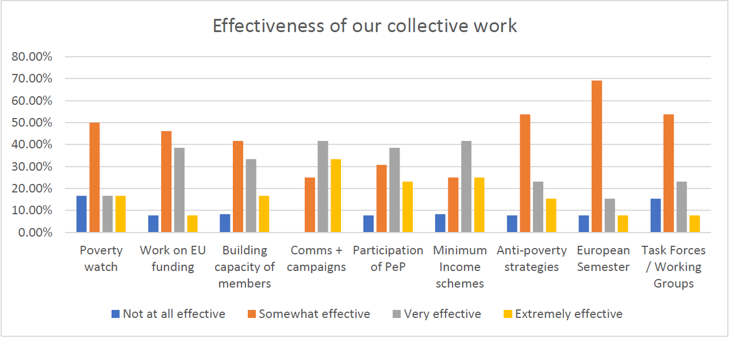

Slide 33
4. Membership: The intensive consultation processes for members are not necessarily delivering on meaningful engagement
Priority Action:
As part of the diversification strategy prioritization needs to be given to projects that build the capacity of weaker members.
Recommended Change:
EAPN to focus on five or six issue areas for the next five years and orientate its structures to have specific, time limited, thematic working groups where members can opt into processes that are of most use and value to them.

Slide 34
Human Capacity: Attention needs to be paid to ensuring that EAPN is maximising on its most important asset, people
24 years - 2 Directors - culture of longevity
Contributory factor high levels of member engagement in management processes
No tenure limits for ExCo or Bureau
Cutbacks and burn out, prioritizing work, tensions and conflict

Slide 35
Human Capacity: Attention needs to be paid to ensuring that EAPN is maximising on its most important asset, people
The history of the EAPN is like a weight – there is too little rotation in the staff and in the members
The same people have been involved for a very long time, we need a new generation coming up
We have low capacity and regular change among some members, no change among other members

Slide 36
5. Human Capacity: Attention needs to be paid to ensuring that EAPN is maximising on
its most important asset, people.
Priority Action:
The Director to lead a review of staffing structures during Phase 3 of the strategic thinking process to ensure that resources reflect the priorities of the organisation, for presentation to the Bureau and sign off by the Ex Co by June 2019.
Recommended Change:
EAPN to adopt tenure limits for participation in all elected roles and a system to actively support the full participation of new members.

Slide 37
Change: Structural reform needs to be implemented to increase effectiveness and participation and reduce duplication

Slide 38
Change: Structural reform needs to be implemented to increase effectiveness and participation and reduce duplication
Debated many times
Time consuming, disheartening
Structures not increasing accountability, participation and transparency
Sometimes lead to contradictions
ExCo vs EUISG

Slide 39
Change: Structural reform needs to be implemented to increase effectiveness and participation and reduce duplication
EAPN have a management board of 35 people – this should be reduced, it is too much of an administrative burden, they need to streamline, it can lead to bad decisions.
Some members think that by meeting three times a year you are in ‘control’ of the organisation, but this is the wrong way to look at it. You control the organisation by being part of the actions and activities, being part of the story.
It is humiliating, it was a complete waste of our time and a kick in the teeth for the staff.

Slide 40
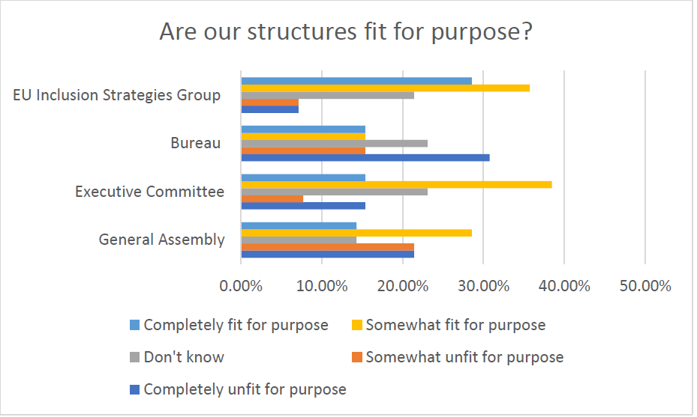

Slide 41
Change:
GA - cumbersome, resource intensive, draining on people and money - exasperates a lot of the negativity in the network
ExCo - too big? Couldn't we have a board of 10-15 people running things. Too many resources.Should not take on policy but look at alternative political scenarios.
Bureau - ExCo and Bureau should be replaced by a small board, lack of transparency
EUIG - needs to innovate, fewer themes with less focus on technical processes, draw on experience and priorities of members
Some dissent - status quo is necessary

Slide 42
