Slide 1


EAPN: Fighting for a Social Europe Free of Poverty
PESTEL analysis – results of staff reflections for Bureau consideration
EAPN Staff Team
August 2018
EUROPEAN ANTI-POVERTY NETWORK

Slide 2
PESTLE analysis
P. Political
E. Economic.
S. Social
T. Technological
L. Legal
E. Environmental

Slide 3
PESTLE output
A simple list of the key factors with just enough information to clearly define each of them, classified as ‘threats’ or ‘opportunities’ and ranked by importance.
Backed up with brief analysis

Slide 4
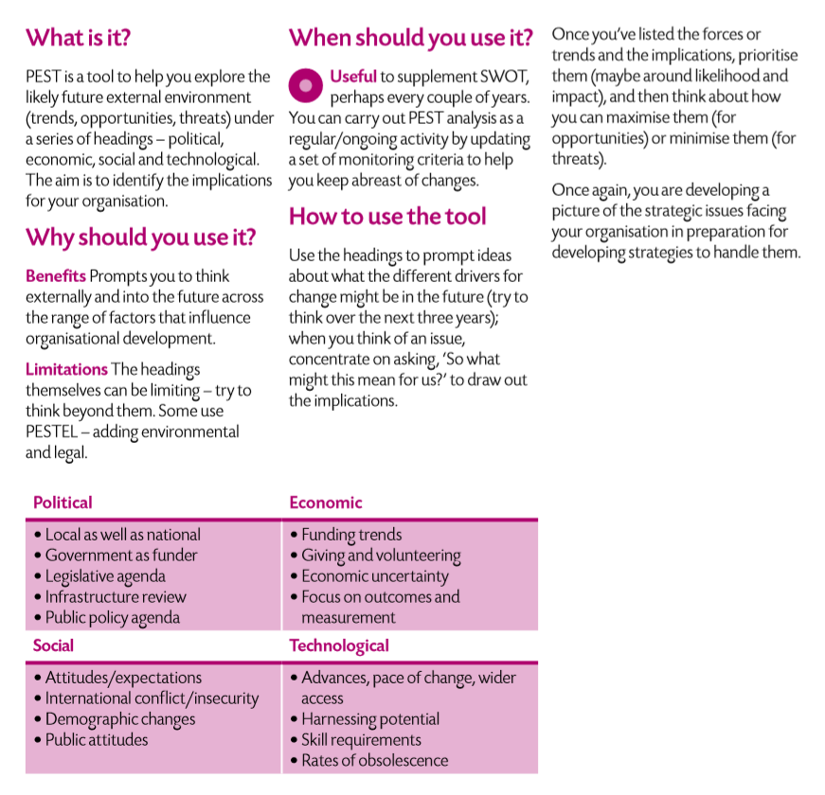
Notes:
DURING OUR REFLECTIONS (as staff, and with bureau and then on Sep 28) WE SHOULD… ask the three important analysis questions:
What... are the key drivers, trends and forces in the external environment?
So what... are the implications for the organisation and key stakeholders and what are the opportunities (and threats and risks)
Now what... should the next steps be? (where should we focus, create strategic options, use the thinking to make decisions / recommendations)

Slide 5
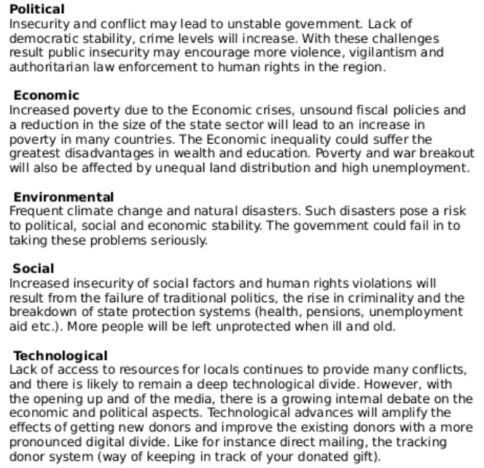
UNICEF example

Slide 6
Next Steps
3 Sep: Bureau / staff discussion on PESTLE and Theory of Change
14 Sep: Background documents shared with EAPN members
28 September: Strategic Thinking workshop to focus on PESTLE and Theory of Change

Slide 7
Remember Our vision
A Social Europe free of poverty and social exclusion with access to economic, social and cultural rights for all.

Slide 8
POLITICAL OPPORTUNITIES
New Parliament & Commission.
Focus on inequality & engagement
Future of Europe – 6th scenario
Social Pillar – impact?
SDGs
Hard law + new frameworks? MI?
Notes:
1 – Potential shift to the left? (Shift to the right is obviously a threat…)
2 – There seems to be growing political pressure to tackle inequality and to connect with citizens (Future of Europe consultations, Macron’s citizen dialogues etc)
3 – Strong linked to 1. Seems to have traction and likely ability to influence the debate and the politics, but it is likely to push the envelope far enough for potential Treaty Changes?
4 –
5 – Big poverty focus, but what buy in / role at EU level? We could use as advocacy hook, and coordinate work our members are doing on this, aiming to access funds via DEAR funding line.
6 -

Slide 9
POLITICAL THREATS
1. Dominant neo-liberal ideology driving Future of Europe vision
2. National political drift to the right with more Eurosceptic left
3. Populism increasing xenophobia, antimigration/anti-solidarity
4. EU budget likely to reinforce Fortress Europe & undermine Cohesion.
5. Reducing role, financing and dialogue space for NGOs

Slide 10
POLITICAL IMPLICATIONS
1. Focus on engaging members and PeP in political consultations
2. Develop EAPN’s political and economic ideology
3. Build on inequality
Notes:
Encourage EAPN members / PeP to be engaged in relevant political consultations, when they are meaningful and likely to have an impact. Will need analysis of which spaces we should be in and which to ignore.
Focus political efforts on building our political ideology for a Europe free of poverty and social exclusion and promoting this in relevant spaces
Inequality is a big part of the fight against poverty and social exclusion and will be for the foreseeable future. EAPN should make this fight an integral part of its identity, with campaigns focusing here

Slide 11
ECONOMIC OPPORTUNITIES
1. Return of growth, but lack of impact on poverty
2. Growth of alternative movements and ideologies
3. EC commitment
4. SDGs
5. Funding opportunities
Notes:
Political space / opportunity to challenge system?
Counties like Spain, Portugal thriving with non-austerity politics, Corbyn, DIEM25, The Rules, Degrowth Movement… Opportunities for partnerships to strengthen our movement.
‘Safe’ core funding and PeP, ringfencing for poverty and social inclusion within MFF, MFF supporting implementation of the Social Pillar through the Semester... How safe in long run?
Space and framework to challenge economic thinking
Funding opps available – EEA, foundations, private, online, crowdfunding, collective projects… Challenge is to tap into it and to prioritise.

Slide 12
ECONOMIC THREATS
Economic neo-liberalism + austerity
National tax policies
Precarious work
Overreliance on EC, EC trends
Lack of funds at national level
Internal management of resources
Notes:
1 – Overarching narrative and organization of our societies and our economies. TINA. Increasing poverty and inequalities – seems unlikely to change unless the politics changes. Does this model rely on certain sector of society being kept in poverty? (Also an opportunity)
2 – again, an opportunity for us to fight against this, as many countries don’t have tax systems which favour moving people out of poverty. Labour taxed more than capital, for example.
3 – More people face economic uncertainty, risk falling into poverty. Likely to be more serious when coupled with risk of reduced social protection and decline in accessible and affordable services
4 - If EC politics changes and we lose our FPA, we are v vulnerable and would need to declare bankruptcy. Good that we have agreed to diversify, need to make this a reality. EC Likely to move more and more to project funding and making it harder to get funds to national networks. Less cash in cohesion budget overall – what will this mean for national level? Delayed procedures leading to potential cash flow problems- planning and timing of work.
5 - lack of cash and ability to get cash in many networks is a huge threat. Inequalities between our networks.
6 – Lack of clarity on decision making around budget allocation, role of structures / staff etc

Slide 13
ECONOMIC IMPLICATIONS
Focus on economic alternatives + economic inequalities
Seriously focus on financial sustainability of the movement
Strengthen internal financial management
Notes:
EAPN to focus on alternatives to growth and alternatives to austerity as a way to combat poverty, collaborating with alternative movements, exploring alternative ideologies and trying to be part of a positive change. Incorporate work on taxation, through alliances. Build on the future of work and in work poverty streams. Could mean a future policy officer focuses on this side of the work.
Funding diversification, leadership engagement, different funding streams, allocate resources to this at European and national level. Focus on small number of high impact projects which provide staff and funds rather than lots of small projects which don’t bring in much money. Provide support to members to grow their funding base, while continuing to push for public funding of anti-poverty NGOs in relevant spaces.
Clarify decision making. Clarify role of Treasurers. Clarify role of Bureau / staff here. Agree how we make financial reallocations and planning.

Slide 14
SOCIAL OPPORTUNITIES
New forms of democracy
Failures of current system for majority
Human empathy
Donations
Notes:
Two big trends to highlight, not clear which one will be more important:
a) Regressive, back to nationalistic values (UK), traditionalist, wanting to go back to how things were, conservative, ‘good, honest, solid values’ are disappearing
b) Opposite trend of people who see the value in diversity in the population, identifying systemic causes, admitting there is no way of going back to white rural industrial… identity
Re-inventing (new ways of) democracy, New collective groups, citizens’ initiative, movements
The vast majority of people are not benefitting from the current narrative (In terms of numbers (99%), accessibility (comms tools), interests… the necessary conditions are there to create change). A big percentage of people know about certain concrete outcomes of austerity (seeing growth of people needing foodbanks). Stress, mental illness on the rise – growing need to rebalance our values…
Most people are potentially empathetic on a basic level, on an individual level
Cultural trend of donating (instead of asking for presents when having a party / wedding etc) provides interesting fundraising opportunities

Slide 15
SOCIAL THREATS
TINA narrative
PeP stereotypes
Individualism
Views on social protection
Mainstream media
Demographic changes
Notes:
1. Current big narrative (neoliberalism) is creating poverty and increasing inequality
2. Stereotypes about pep (including migrants), lack of knowledge about Poverty and Pep
Poverty still seen as an individual problem, ‘if you try hard enough’
people blame a certain group for (their) poverty
Fear / distrust of ‘others’
3. Individualism, people act less as defined groups, members of a certain group, but become consumers, clients, sometimes in competition. People are less likely to feel solidarity with others
4. Social security, solidarity, social protection seen as a luxury, unrealistic, old fashioned
5. Media in hands of profit driven companies, colouring our worldview, for example views on migration quite negative and big impact
6. Demographic changes are likely to create more poverty

Slide 16
SOCIAL IMPLICATIONS
EAPN to focus on challenging narratives
EAPN to build strength in numbers
Notes:
Challenging neoliberalism and austerity, proposing alternatives, challenging views and stereotypes on poverty, changing the frames of the political, public and media discourse (with focus on poverty, inequality and social protection). Will need deep expertise and thinking on economic models.
Potential of tapping into culture of new ways of organising by defining ourselves as a movement and opening up to individual membership at national and European level.

Slide 17
TECHNOLOGICAL OPPORTUNITIES
Global access
Concrete advances
Communication tech
Access to info
Data and poverty
Notes:
Remarck
New technologies aren’t ‘good’ or ‘bad’ as such, but it depends on how they are used, they could offer great opportunities for the fight against poverty and social exclusion, but depends on the model of society,
Example: 3D printers could be used to print houses, fast and cheap, if so, accessibility of quality (social) housing could increase, at the same time, jobs (construction) are lost, so this needs to go hand in hand with social investment in new jobs and social protection
1. We now have direct access to the whole world – this means access to a bigger audience via social media, opportunities to build bigger communities, direct access to members, and possibilities to build new relationships with different partners
2. Concrete opportunities to overcome poverty situations, using new technologies, for example 3D Printing houses
3. Opportunities for EAPN using new technologies: iphone interpretation services, online meetings,…
4. Access to information, education (both better and worse: internet as huge source vs no access). Inequality?
5. Availability of data: Tracking systems to identify poverty situations – prob of disaggregated data though… Also, Tracking/monitoring our reach and level of engagement and impact

Slide 18
TECHNOLOGICAL THREATS
Who benefits?
Threats to jobs
Digitilization of services, benefits etc
Fake news, elections
Power
Notes:
1. More power (money) in fewer hands (big companies can afford robotization of production process, use artificial intelligence in marketing…) Deep technological divide, less access (to services) for people experiencing poverty, entrenching inequality?
2. Jobs disappearing (low skilled jobs, ‘bullshit’ jobs ). We, and society, could also see this as an opportunity…
3. Computer illiterate, poor people excluded from such services Society is becoming more and more complex, you need specific skills, older people are excluded (less personal services, automatization of services)
4. Fake news, impact on elections, populist parties…
5. Are tech companies becoming more powerful than governments? Threats to tax systems, governments losing power, (linked to the economic analysis and political analysis)

Slide 19
TECHNOLOGICAL IMPLICATIONS
Technology / inequality
EAPN as innovator?
Use comms technology to mobilize and dynamise our movement
2.
3.
4.
5.
6.
Notes:
Link Inequality and technological advances: future opportunities: piece of work?
Can EAPN become a partner in innovative ways to fight poverty? Eg. Projects exploring possibilities to use technology to fight poverty (printing houses, use Artificial Intelligence) To what extent do we want to go down that road?
How does the direct access to individuals all over Europe influence our potentials as a mobilising organisation? As part of a new movement? As a membership organisation?

Slide 20
LEGAL OPPORTUNITIES
Human Rights treaties
EU Treaties + legislation (existing and new)
National legislation
Soft law
Participation – potential future Treaty Change?
Pro bono
Notes:
1 – we could incorporate existing HR legislation (and other instruments designed to protect against poverty) into our work. This would give us solid legal basis for our advocacy and could open up new and different partnerships. Would also be very coherent with our vision and values. We have done existing work on this (HR taskforce) and we have existing expertise in the staff team and our members.
2 – Good overview here: http://www.europarl.europa.eu/factsheets/en/sheet/60/the-fight-against-poverty-social-exclusion-and-discrimination EU treaties and legislation includes competencies to fight poverty and social exclusion. New Commission etc may provide impetus for new legislation, which could be beneficial.
3 – Anti-poverty strategies / frameworks at the national level. Some countries have, some are developing… Influencing policy and legislation at the national level is a good opportunity for our members.
4. SDGs and Social Pillar provide good advocacy and monitoring opportunities for EAPN and our members, should we choose to focus here.
5. Civil society vs. social partners

Slide 21
LEGAL THREATS
Lack of legal expertise
Weak internal legal procedures
Contract with EC prohibits specific legal work
Changes in Belgian Association Laws
Challenging legal env at national level
Notes:
1 – Coupled with complicated and changing Belgian laws, this leaves us vulnerable and struggling to understand relevant Belgian legislation. Can be rectified by joining FAIB: http://faib.org/home/ and / or getting probono legal advice (via The Good Lobby) or ensuring legal expertise on Bureau / Ex Co, or by allocating funds each year for legal advice…
2 – Work rules are particularly weak and need updating to reflect reality and legal context, specifically around employment law. Standing Orders could be tightened up. Legal understanding of Ex Co needs to be strengthen.
3 – We cant make legal challenges against any MS using our core funding
4 – Changes coming in over next couple of years. Need to keep on top of this, don’t see big threats here
5 – Poland, Hungary, Austria etc. What this will mean for our national networks, how to protect against this in future. How to react as EAPN?

Slide 22
LEGAL IMPLICATIONS
Strengthen EAPN’s legal capacity
Develop work on linking fight against poverty with HR treaties
Re-examine existing EU Treaties / instruments
Prepare for future Treaty Changes, new legislation
Challenge negative developments
Notes:
Join Federation of European and International Associations in Belgium, ensure we have legal expertise on Bureau or Ex Co, get legal advice through our Social Secretariat and / or seek pro bono legal advice through The Good Lobby, refine Statues, Standing Orders and work rules (Working Group). Set aside a small amount of funds for legal consultation if needed.
Careful to ensure we don’t move to fast for our membership here, and don’t create impossible expectations of winning legal cases throughout Europe – this work could entail better incorporating HR treaties into our advocacy work,
Develop clear understanding within membership of treaties and instruments at our disposal, ensuring our staff and members are able to use EU structures and legislation to make change. (Working Group? Annual training offered?)
Monitor what is happening at EU level and prepare accordingly
Develop partnerships with organisations like FRA, OCHCR, Civicus, to challenge negative developments at national level through the media and if necessary the courts

Slide 23
ENVIRONMENTAL OPPORTUNITIES
1. Environment / social
2. Way to focus on marginalized
3. Existence of legal environmental frameworks
4. Transition Movement
Notes:
1 – Realisation that env and social orgs are part of the same fight in Europe and globally – partnerships are totally there to be made. Think Friends of the Earth. We already have a good reputation thanks to our work on energy poverty – the question is whether we place a high level of strategic importance on particular environmental issues
2 – Globally, the most vulnerable countries are those most affected by climate change (think low lying Pacific islands). In Europe, the situation is likely to be the same. This gives us an opportunity to shine a spotlight on the issue and to frame political and policy responses which would protect PeP.
3 – Possibility of linking Paris Agreement to poverty and social inclusion. For example, the transition from fossil fuels which is needed to meet the 1.5 – 2% carbon emissions target will need more skilled workers. Can we push for retraining low paid fossil fuel workers, for example?
4. A way to rely less on fossil fuels and expensive energy – see https://www.theguardian.com/environment/2013/jun/15/transition-towns-way-forward and the network here https://transitionnetwork.org/ Question is the long term impact this could have on poverty and social exclusion

Slide 24
ENVIRONMENTAL THREATS
1. Impact of climate change
2. Climate migration
3. Impact of transition from fossil fuels
Notes:
1 – Heatwaves throughout Europe of 2018, likely to continue / worsen – biggest impact likely to be on people experiencing poverty. See https://www.theguardian.com/science/2018/aug/14/extreme-temperatures-especially-likely-for-next-four-years and https://
2 – Linked to 1. Likely to see more climate related migration in the future – what will this mean for Europe, how will we protect the rights of future migrants?
3 – Obviously a very positive thing overall, but how will EAPN ensure that people are not totally left behind? What becomes of jobs in fossil fuels? What will be our position on this?

Slide 25
ENVIRONMENTAL IMPLICATIONS
1. EAPN should plan for a future in which climate change has a big impact on people experiencing poverty in Europe.
Notes:
1 – We should recognize the impact climate change is likely to have on PeP in Europe. This would mean commissioning research (or tapping into research) and thinking meaningfully about the work we could put in place in future years, recognizing that climate change is increasing problems in Europe. We should aim to be ahead of the curve on this, and look to develop meaningful partnerships with other actors to ensure that we are well set up to deal with this reality.

Slide 26
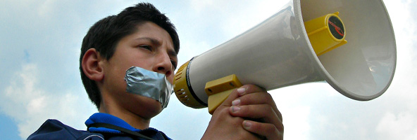
Thank you for your attention
EUROPEAN ANTI-POVERTY NETWORK
RÉSEAU EUROPÉEN DE LUTTE
CONTRE LA PAUVRETÉ ET L’EXCLUSION SOCIALE
BOULEVARD BISCHOFFSHEIM, 11 – 1000 BRUSSELS
TEL: 0032 2 226 58 50
www.eapn.eu - team@eapn.eu
Follow us on Facebook, LinkedIn and Twitter @EAPNEurope

