Slide 1
COMM’ON GUIDELINES

Slide 2
About the COMM’ON Group

Slide 3
Comm’On Group
EAPN Communications Working group, aka ‘COMM’ON’ GROUP
NAME:
CREATION: 2018
TASK:
give guidance to the EAPN Communications work, with a specific focus on:
how PEP can participate in this work,
how their voices, experiences and perspective can be made more visible.

Slide 4
COMPOSITION:
EAPN AT
EAPN NL
EAPN NO
EAPN
IE
EAPN
PL
EAPN PT
A
DUO
INSIDE EACH
Including a PEP

Slide 5
OBJECTIVES
Making the comms work of EAPN more participatory
1
2
Amplifying the voice of PEP
15-35
3
Strengthening our comms towards/for PEP
30%
4
Learning from each other
36-65
Developing guidelines to link the comms work to a participatory way of work
5
70%
6
Strengthening the visibility of EAPN, develop more effective comms work

Slide 6
Table of Contents
01
02
03
PARTICIPATION OF PEP
CAPACITY BUILDING AND TRAINING
AMPLYFYING THE VOICE OF PEP IN OUR COMMS WORK
04
05
PR AND VISIBILITY
ACCESSIBILITY OF OUR COMMS WORK

Slide 7
01
Participation of PEP

Slide 8
AIM
Participation of different types of stakeholders in the social policy sphere has always been a major concern for EAPN but in this, its strongest focus and mission has been to enable the direct participation PEP.
Current situation: despite a rich experience with participatory work, EAPN is still struggling to ensure that PEP’s participation is not simple rhetoric but transformative practice!
EAPN wants to enable meaningful participation in ALL our areas of work
Analyse and change the power dynamics
Invest in empowering PEP
HOW

Slide 9
GUIDELINES
Make sure you understand where your organisation stands in terms of participation
Empower PEP to participate – through training and practice
Before any participatory work:
Look inside your organisation
Have an honest conversation
Do a collective analysis of:
The distribution of power
The barriers to participation
Deal with potential internal barriers:
Participation fatigue
Lack of:
Confidence to speak up
Formal education

Slide 10
GUIDELINES
Define clearly with the group of PEP: what they are asked to participate in and what contribution they are expected to make!
Ensure that participatory work is supported throughout the whole process by one or several members of the organisation
During the participatory work:
Find out:
Their understanding of participation
Their goals
Their means
Identify internal barriers:
Ensure that effective participation is the core of your work
Support and promote the development of decision-making structures:
Open
Accessible
Inclusive

Slide 11
GUIDELINES
Develop rules together with the group, and make sure everyone understands them and adheres to them
Remember about participation and representation rules
Evaluate the work done with the whole group and try to learn from both successes and failures
Learn from other experiences
To achieve individual & collective empowerment:
Spend enough time with the group
Discuss the idea of representation
Elect legitimate representatives
Collectively establish rules
Develop the negotiations skills of representatives

Slide 12
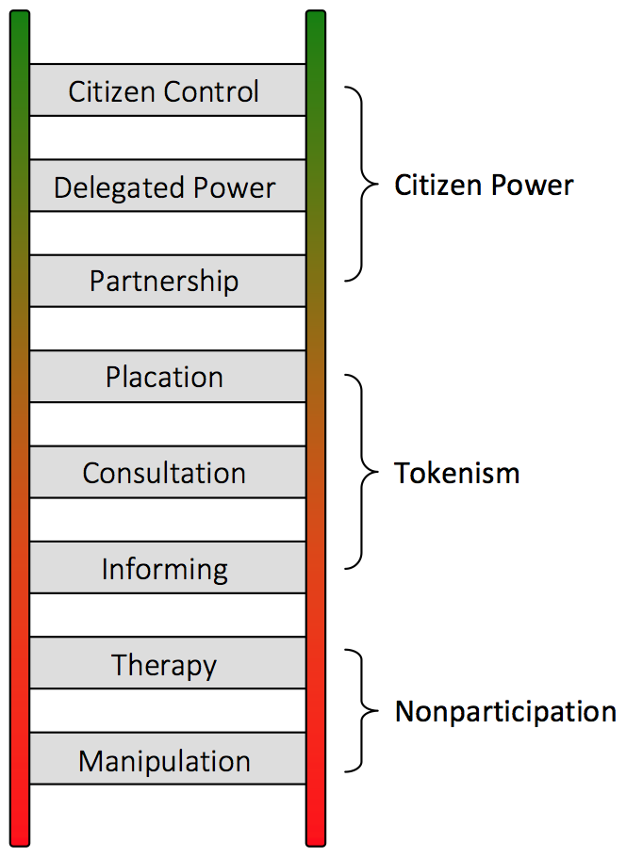
INSPIRATION BOX
Revisit Arnstein’s ladder of participation
Read John Gaventa’s article ‘Finding the Spaces for Change: A power Analysis’
Checklist for networks/organisations when doing participatory work:
Operating inclusively + develop guideline to ensure that diversity is recognised and valued
Address specific barriers e.g. childcare…
Ensure work is based on the group’s needs
Demonstrate and celebrate outcomes from their participation
Openness and transparency

Slide 13
02
Capacity Building and Training

Slide 14
AIM
Exploring how we can enable meaningful participation of PEP in the communications work carried out by EAPN?
Ultimate goal: PEP get a very high status and recognition of their knowledge and skills within the work of the EAPN
PEP become involved in all decision-making processes.

Slide 15
GUIDELINES
Ensure that the decision-making reach a common decision on the role and participation of PEP in all relevant decision-making levels Spend enough time with the group
Education activities must be offered through regular organisation of repetitive workshop:
Several trainings per year
Longer meetings
Preparatory work and minutes written in plain language
1. Establish common approach to PEP participation in all relevant decision-making levels
2. Plan education activities about public and media relations in a regular and accessible manner

Slide 16
GUIDELINES
Training and capacity building activities:
Organised at 2 levels
Comms workshops
Practice a solution-oriented comms
Media workshop
Interview training
Plain language
3. Organize training and capacity building activities

Slide 17
STEPS
Set up an EAPN Project Budget/Fund
Develop written samples of successful trainings
Create regional cross-border trainings
Organising ‘Train the trainers’ activities

Slide 18
INSPIRATION BOX
Link to national examples:
Capacity building:
EAPN Austria
EAPN UK
EAPN Portugal

Slide 19
03
AMPLIFYING PEP’S VOICES IN OUR COMMS

Slide 20
AIM
Outline basic guidelines on how to amplify PEP’s voices
PEP should be recognised for their knowledge and skills within the work of EAPN!
EAPN wants to:
Involve them more actively in our comms work
Give them a platform and opportunities to speak up
Not only make sure that PEP recognise EAPN as ‘their’ organisation but also to make our comms work more impactful

Slide 21
GENERAL GUIDING PRINCIPLES
→ Necessary structures should be put in place to collect their:
Amplifying adding quotes or messages
→ Create platforms and space in all our comms works, where their voice is included directly
Input
Views
Knowledges
Expertise

Slide 22
GUIDELINES FOR DIFFERENT TOOLS AND MEDIA
Identify/create comms tools according to the needs
Reflect together on how you can turn those tools into platforms
Involve PEP in all the steps & identify them as target group
Show the realities of PEP through
1. Choose your spaces for comms & act strategically
2. Use social media in a strategic way to amplify PEP voice
Real life stories
Quotes, testimonies

Slide 23
GUIDELINES FOR DIFFERENT TOOLS AND MEDIA
Put PEP in the driving (writing) seat:
PEP as a spokesperson
Co-write press releases and op-eds
Have a specific page of your site dedicated to participation:
Activities publications, news
Real life stories
3. Involve PEP (actively) in (traditional) Press and media work
4. EAPN Websites should try to present the whole picture, including poverty experiences and views of PEP

Slide 24
GUIDELINES FOR DIFFERENT TOOLS AND MEDIA
Involve PEP in the development of publications from the earliest stages
PEP should always be CENTRAL in our campaigns!
Involvement of PEP in the:
5. Remember that EAPN Publications are natural spaces for PEP input
6. EAPN Campaigns are for and with PEP
Development
Implementation
Evaluation

Slide 25
GUIDELINES FOR DIFFERENT TOOLS AND MEDIA
Co-write newsletters with PEP
Or
Make sure of their involvement in the editorial group
Develop videos as it is a great tool to share real life PEP in the:
Newsletters
Videos

Slide 26
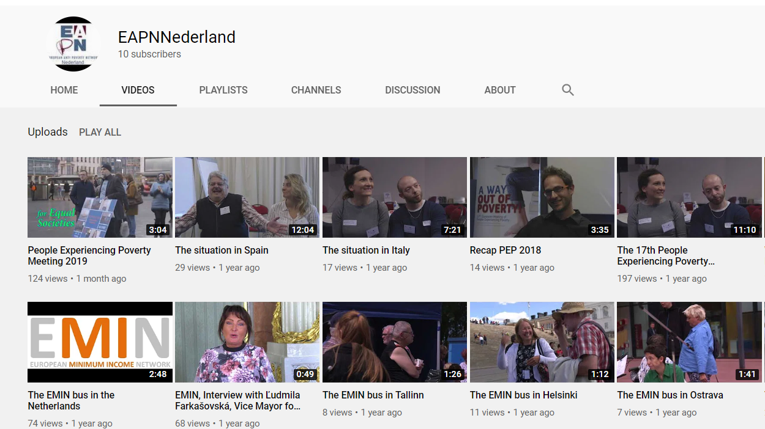
INSPIRATION BOX
Using different platforms to amplify PEP’s voices:
Videos: EAPN Netherlands
Newsletters: EAPN Spain
LinkedIn: EAPN Netherlands

Slide 27
04
ACCESSIBILITY OF OUR COMMS WORK

Slide 28
AIM
TARGET AUDIENCES:
Current Situation:
Wanted Situation:
EU institutions, national and EU level decision makers, administrations, and other stakeholders
Less experience with communicating towards a wider public
Still EU institutions, national and EU level decision makers, administrations, and other stakeholders
Experienced with communicating towards a broader public

Slide 29
AIM
ACCESSIBILITY
Important to identify which TARGET AUDIENCES we are aiming at
UNDERSTANBLE
EASY ACCESS

Slide 30
GUIDELINES RELATED TO LANGUAGE
Essential for the success of our content strategy
Help to break down stereotypes about (people experiencing) poverty and raise awareness
Longer-term objective: plain language
Intermediate steps:
1. Using the national language
2. Aim to use plain language
Specific publications in plain language (i.e. when PEP are the target audience)
Hiring experts to translate papers

Slide 31
GUIDELINES RELATED TO CONTENT
Essential for the success of our content strategy
Help to break down stereotypes about (people experiencing) poverty and raise awareness
Will have a positive impact on:
1. Highlight human stories, realities and experiences from the ground
2. Involvement of PEP from the beginning
The content
The accessibility of our ‘products’

Slide 32
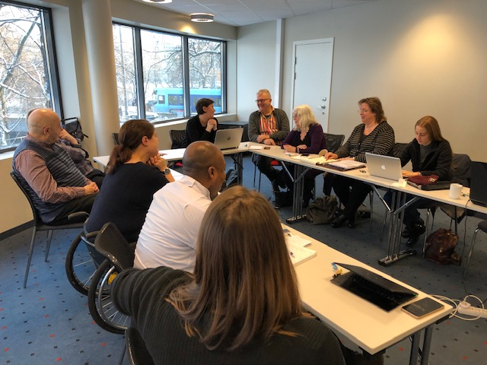
GUIDELINES RELATED TO STYLE
Use alternative tools:
Picture with a short text
Comm’On First Meeting in Oslo.
1. Not only focus on the language but also to show things visually
Infographic

Slide 33
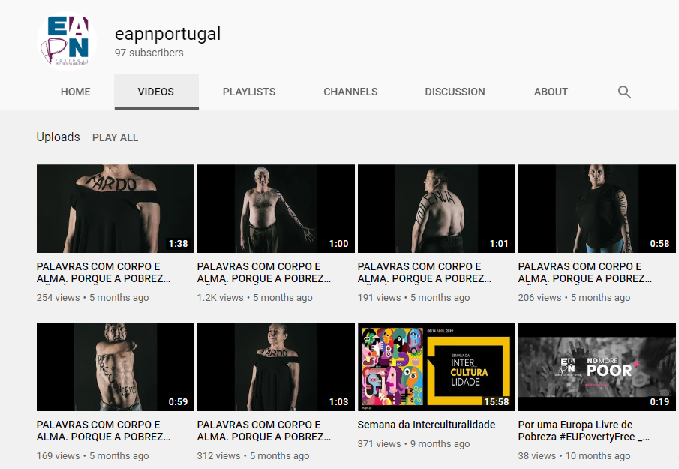
INSPIRATION BOX
Plain language resources
Check out the videos made by:
EAPN Netherlands & Norway
EAPN Portugal
Check EAPN Netherlands’ placemats

Slide 34
05
PR & VISIBILITY

Slide 35
AIM
Give guidance and inspiration on how to give EAPN more profile and visibility
Current situation: not very well known to the general public
Reasons:
Not a single issue organisation
Not a direct service provider
Relatively limited in capacity
Focused on advocacy work
BUT several opportunities to increase visibility and build public support are foreseeable

Slide 36
GUIDELINES RELATED TO THE ROLE OF COMMS WORK IN EAPN
Don’t underestimate comms!
Comms = critical tool for effective policy and and advocacy work & building public support
Ideally, every organisation should have:
A Comms Officer
A PEP as a spokesperson
1. Establish comms as organizational priority
2. Organise the comms work in a way that reflects this organizational priority

Slide 37
GUIDELINES RELATED TO THE ROLE OF COMMS WORK IN EAPN
EAPN and Members should take more control over comms together through:
A Joint Comm Strategy
A Join Comm Action Plan
EAPN and Members should:
Develop and control our content and narrative
Define:
3. Preparation and implementation of a coherent comms strategy
4. Content & narrative
What we want people to think about us
How we want people to think about poverty

Slide 38
GUIDELINES RELATED TO SOCIAL MEDIA
Intensify and coordinate the use of Social Media
First step: connecting to all other EAPN members
1. Great opportunity to strengthen our visibility & raise our profile
Next step:
National
Strategy
2. Translating the EAPN Social Media Strategy
Joint
Action Plan

Slide 39
GUIDELINES RELATED TO TRADITIONAL PRESS AND MEDIA
Create a platform for PEP
Keep reaching for the local level
Develop a strategy to be able to hire a media officer and (PEP) spokesperson
Maintain the contact
1. Involve PEP in this process
2. Do not ignore the local level
3. Comms officer and (PEP) spokesperson
4. Build up a good contact list and relationship with specific newspapers…

Slide 40
GUIDELINES RELATED TO VISUAL IDENTITY, STYLE AND BRANDING
National Networks should use the same branding (e.g. logo…)
Develop goodies/ merch:
Gadgets
Bags
1. Use our branding in a consistent way
2. EAPN visible:
Out there online
In the daily lives of people
Invest time, money…

Slide 41
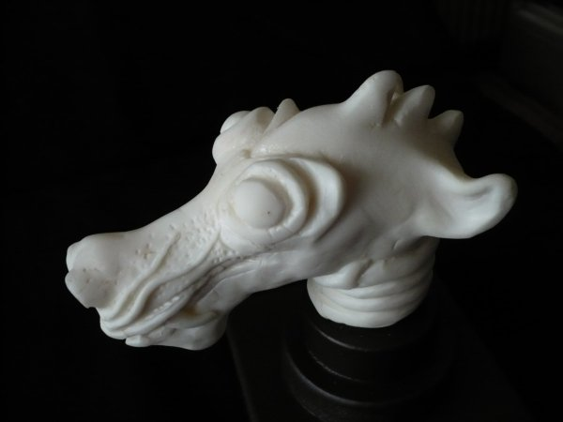
INSPIRATION BOX
Link to national examples:
EAPN Austria Journalism Prize
EAPN Finland Publication about working with PEP in the media
EAPN UK work on Press and Media with PEP
Check out www.forachange.org

